Slide 1
HCDE 598 Digital Fabrication
Molding and Casting!
Instructor: Nadya Peek
TA: Joshua Vasquez
hcde598-sp19.slack.com

Slide 2
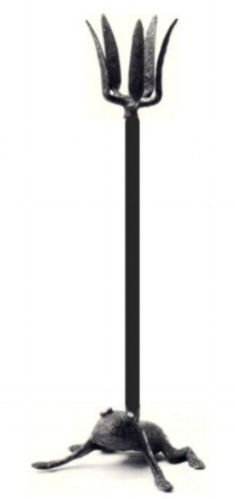
Molding and casting: 3200 BC

Slide 3
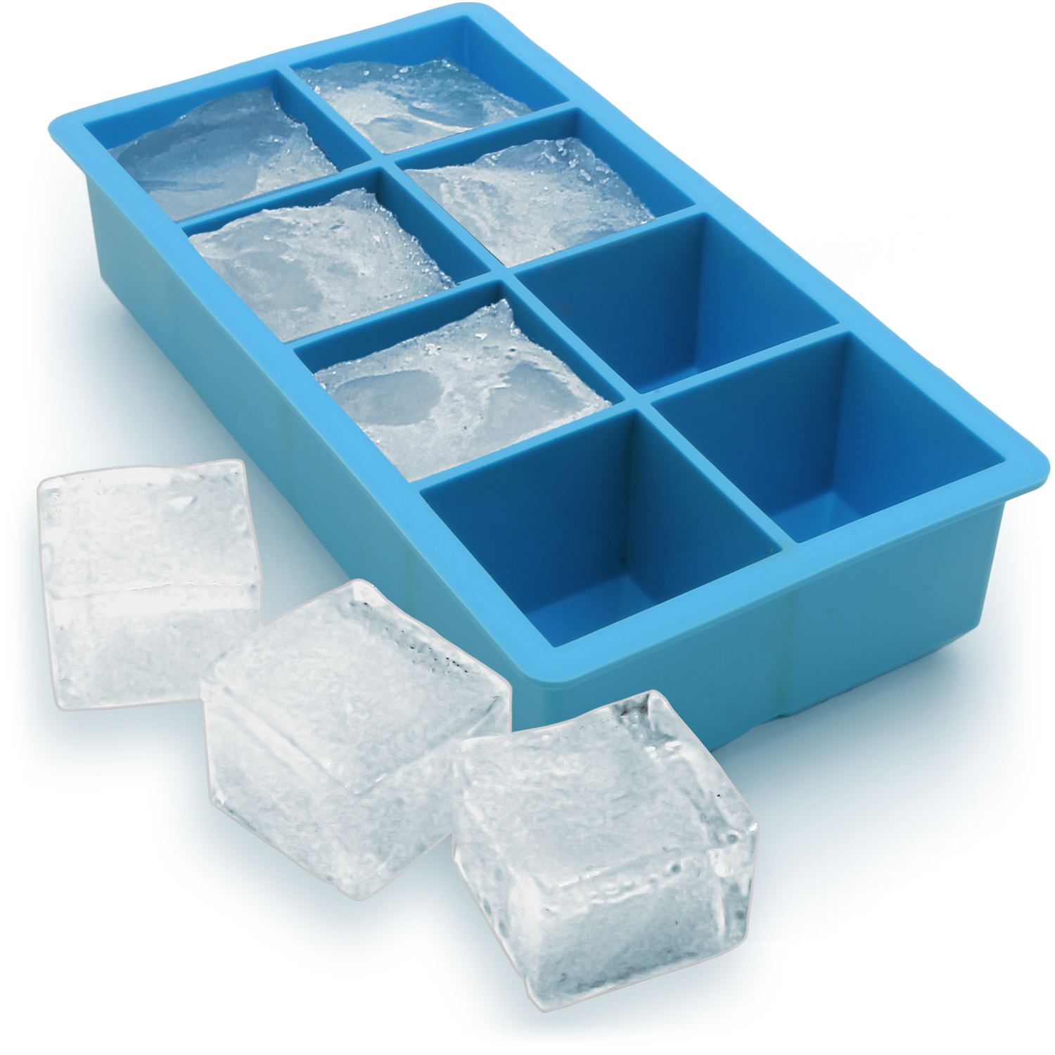
Molding and casting: today in your kitchen

Slide 4
Molding and casting:
A soft material (liquid or pliable) is cast into a hard material that gives it its shape!

Slide 5
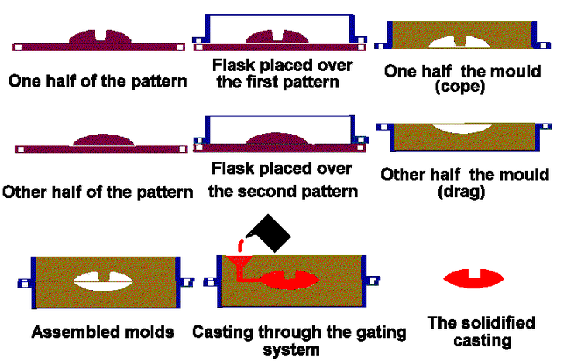
Metal: sand casting

Slide 6
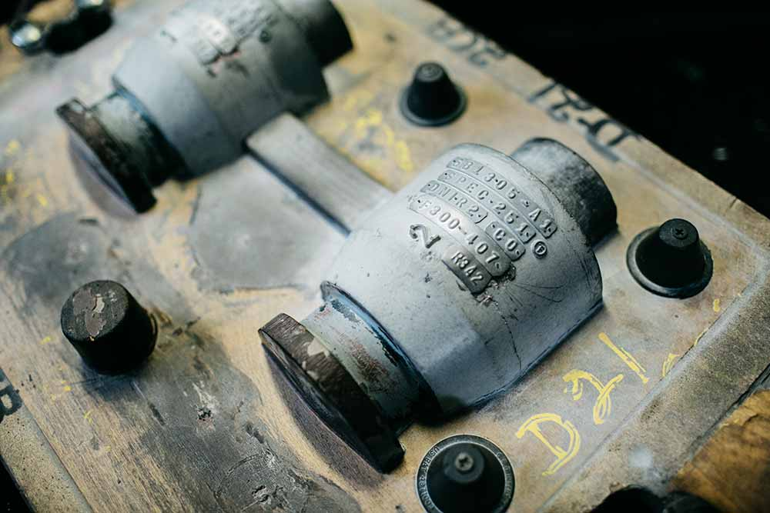
Metal: sand casting

Slide 7
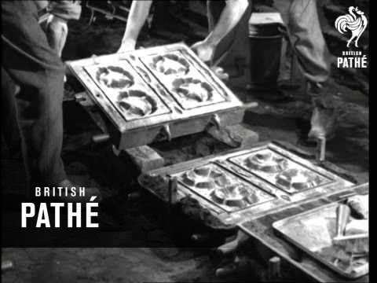
Metal: sand casting

Slide 8
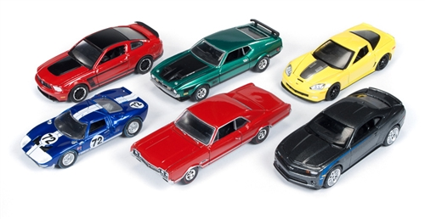
Metal: die casting

Slide 9
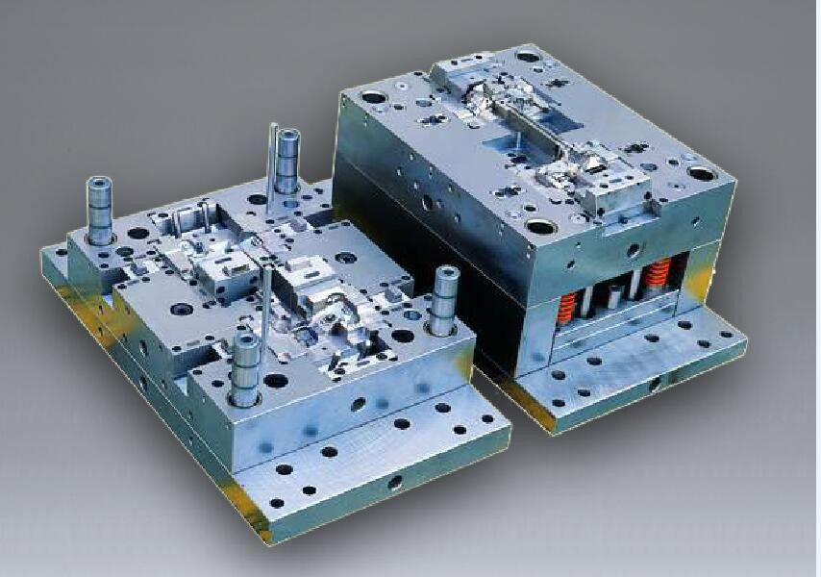
Metal: die casting

Slide 10
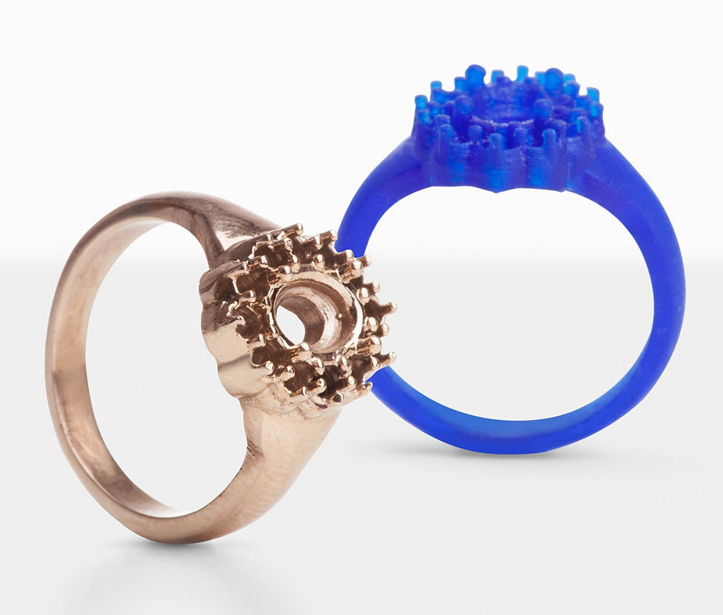
Metal: investment casting

Slide 11
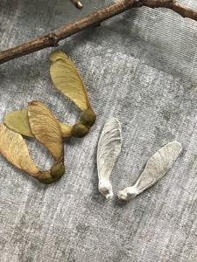
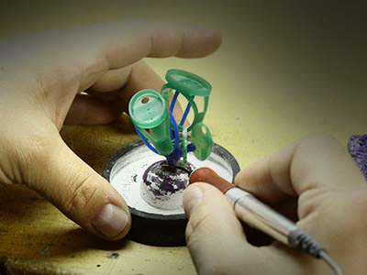
Metal: investment casting

Slide 12
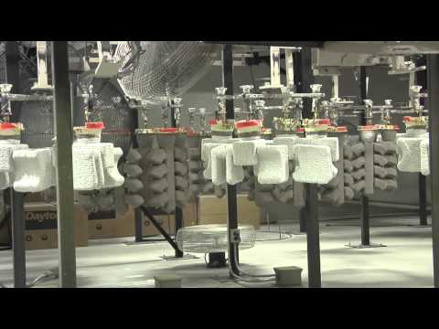
Metal: investment casting

Slide 13
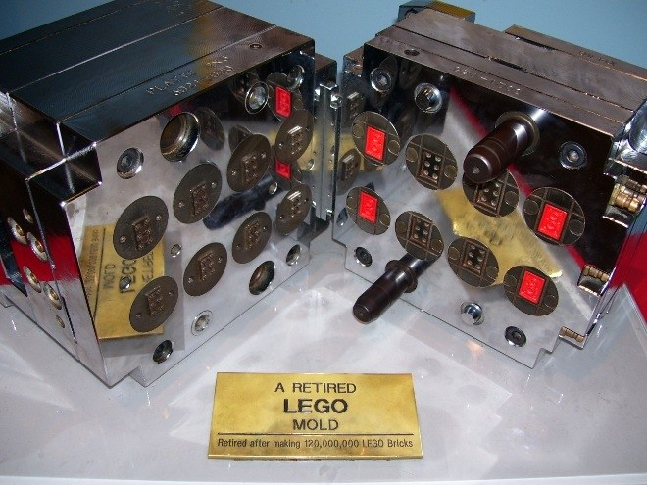
Injection molding: invented 1872

Slide 14
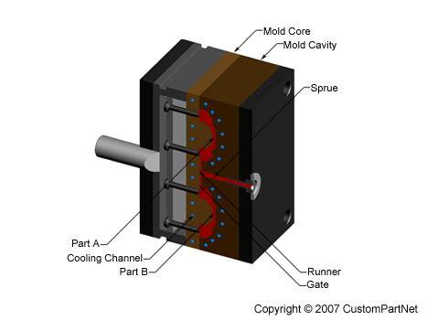
Injection molding

Slide 15
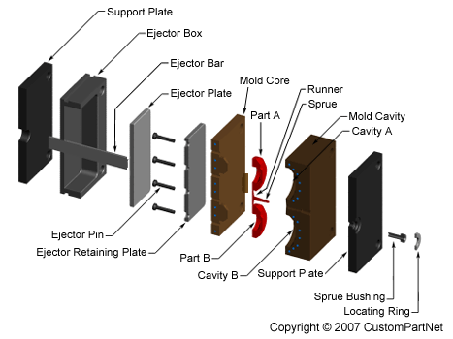
Injection molding

Slide 16
Casting terms:
Mold
Mold core
Sprue
Runner
Key
Parting line

Slide 17
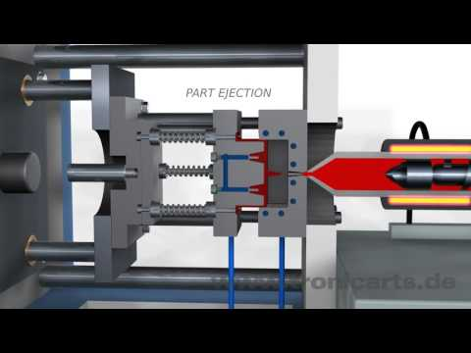
Injection molding

Slide 18
Injection molding

Slide 19
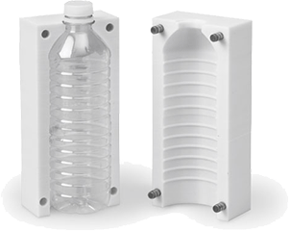
Blow molding

Slide 20
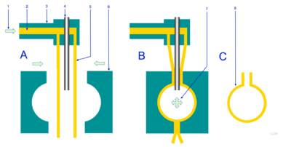
Blow molding

Slide 21
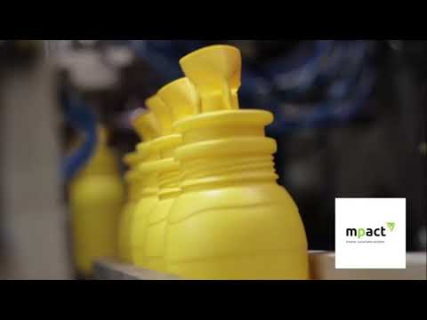
Blow molding

Slide 22
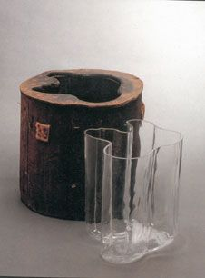
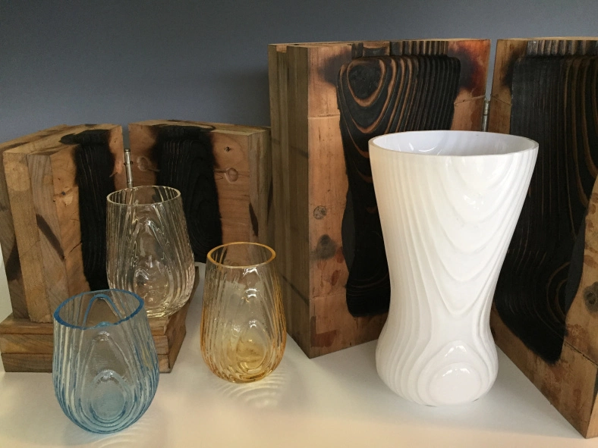
Blow molding glass

Slide 23
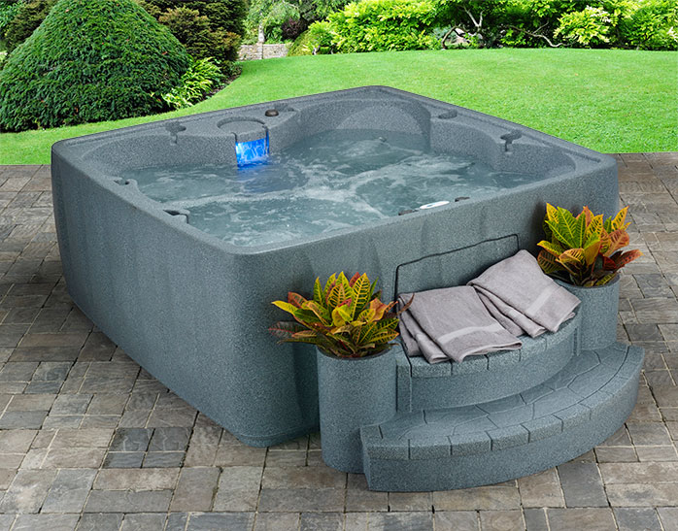
Rotomolding

Slide 24
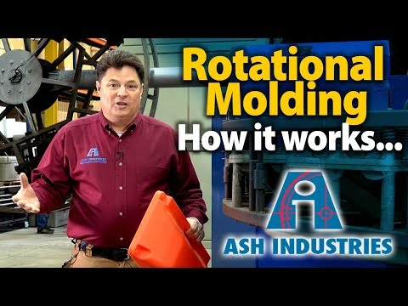
Rotomolding

Slide 25
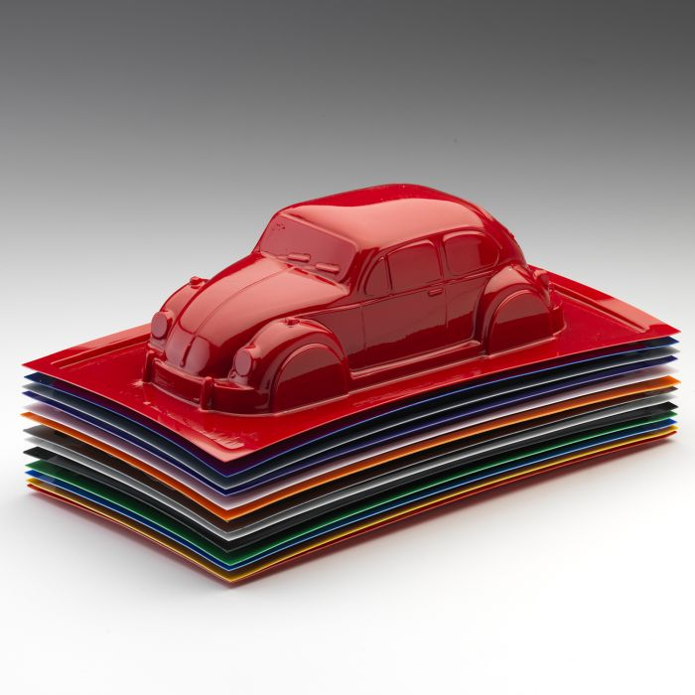
Thermoforming: vacuum forming

Slide 26
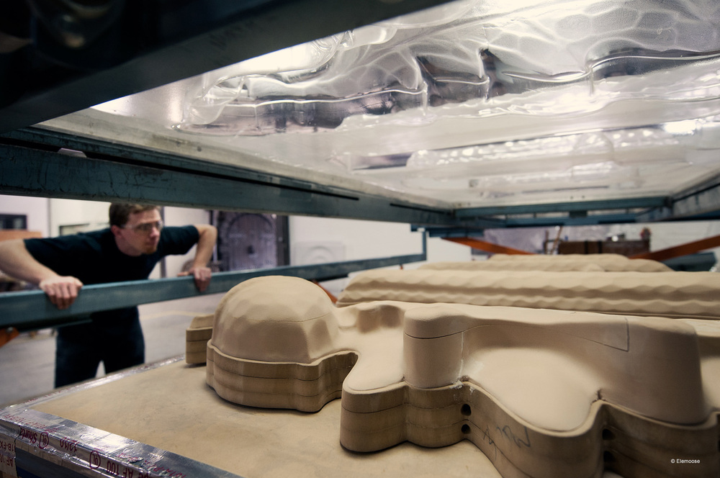
Thermoforming: vacuum forming

Slide 27
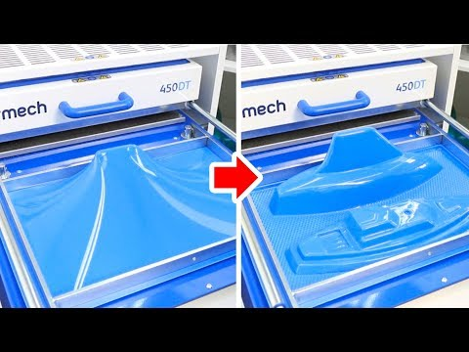
Thermoforming: vacuum forming

Slide 28
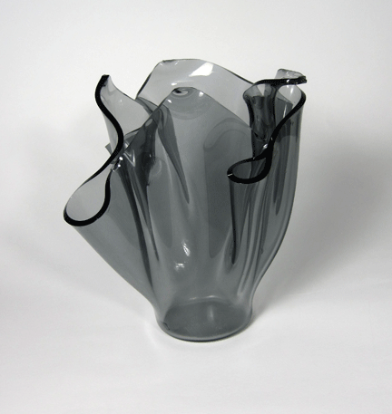
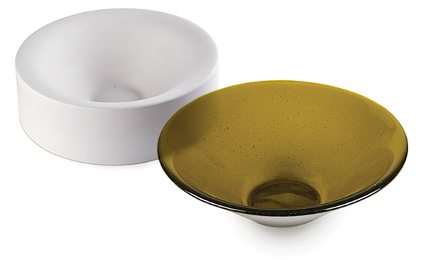
Thermoforming: slumping

Slide 29
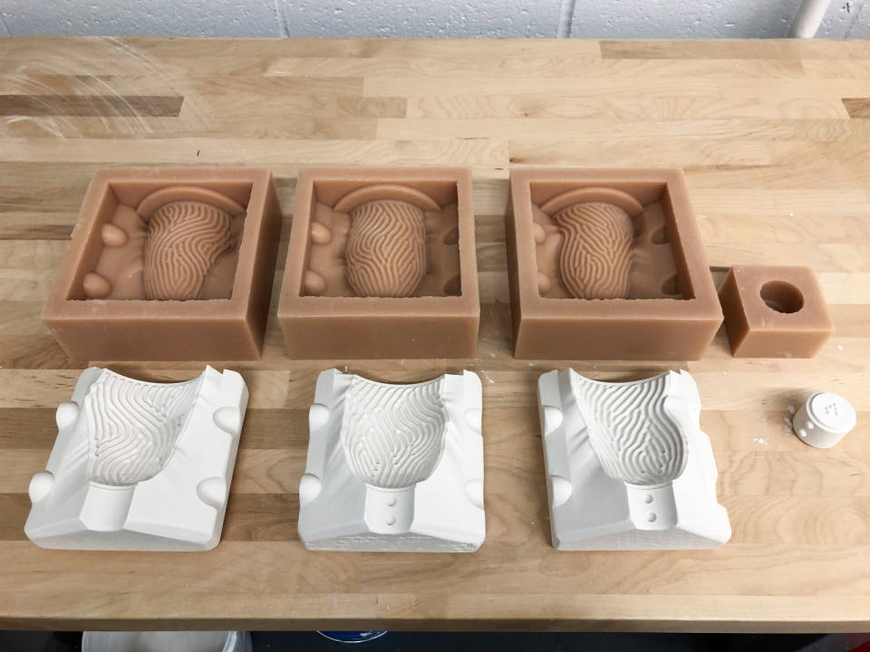
Ceramic: slip casting

Slide 30
Ceramic: slip casting
https://vimeo.com/298395215

Slide 31

Ceramic: slip casting

Slide 32
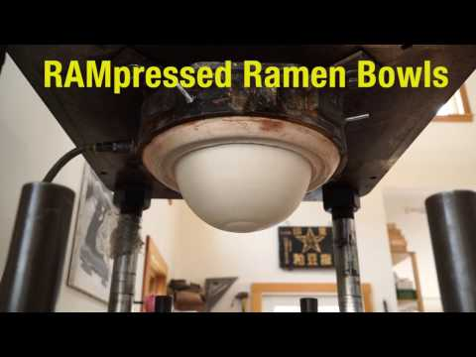
Ceramic: ram press

Slide 33
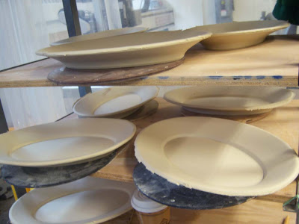
Ceramic: ram press

Slide 34
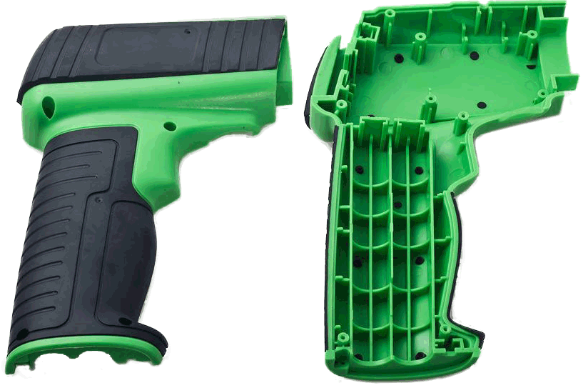
Overmolding

Slide 35
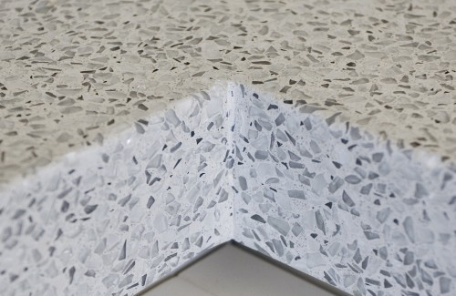
Cast in place

Slide 36
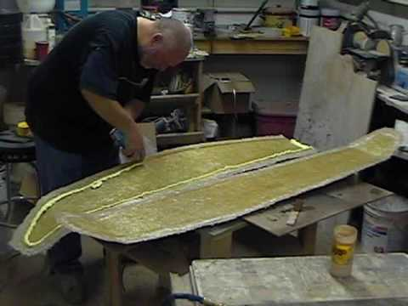
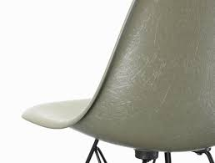
Composites

Slide 37
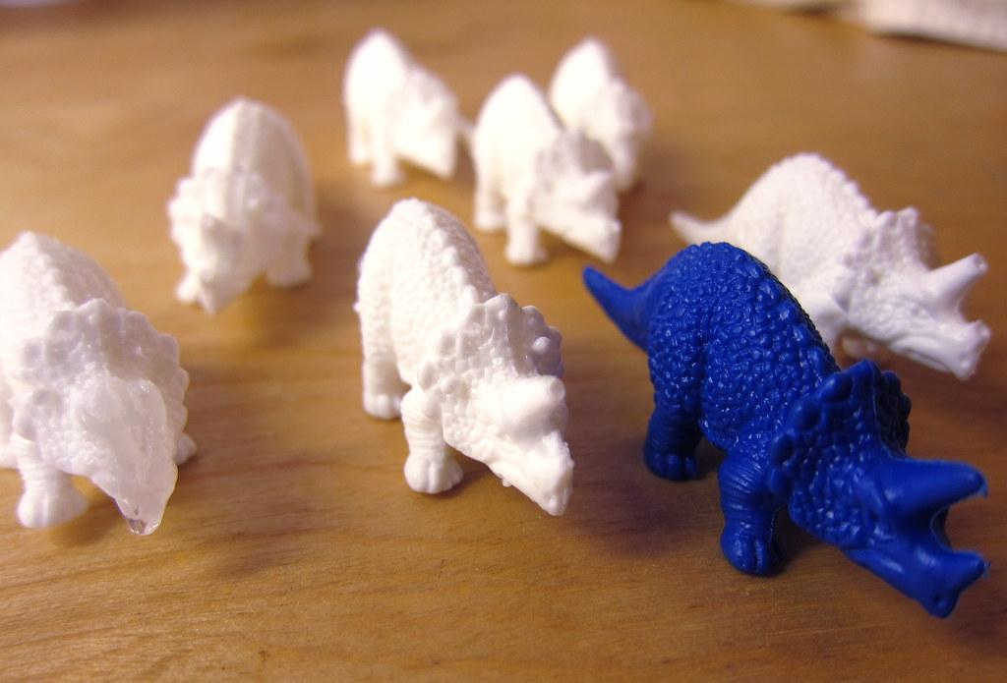
Why casting? Multiples, fast, materials

Slide 38
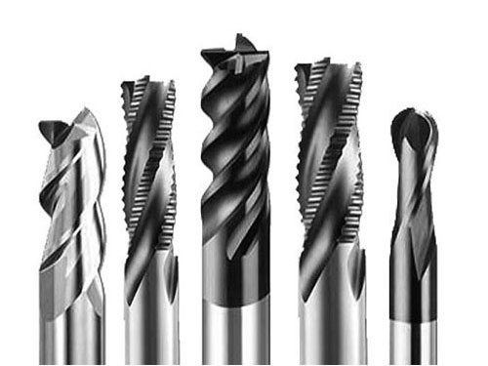
Tooling: cutting tool

Slide 39
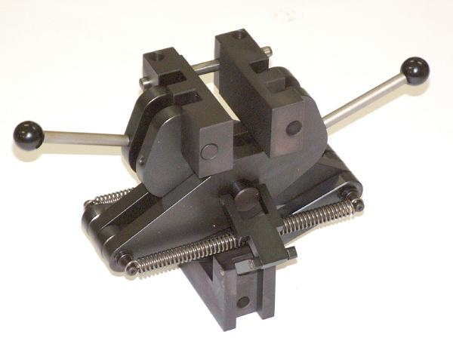
Tooling: fixturing

Slide 40
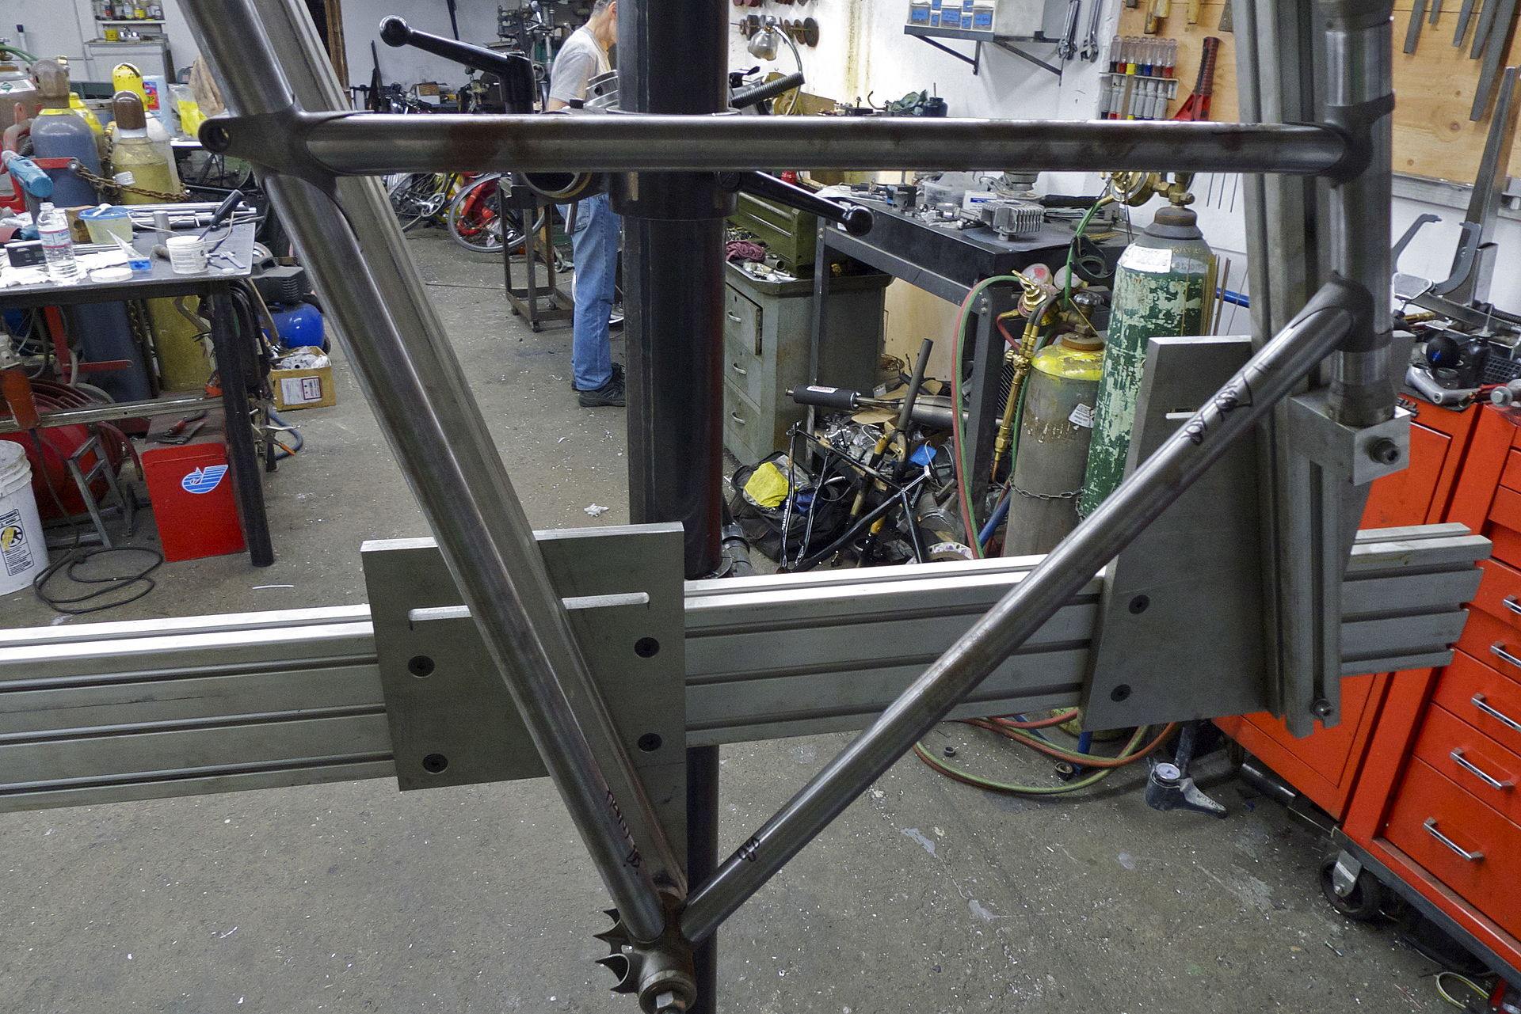
Tooling: jigs

Slide 41
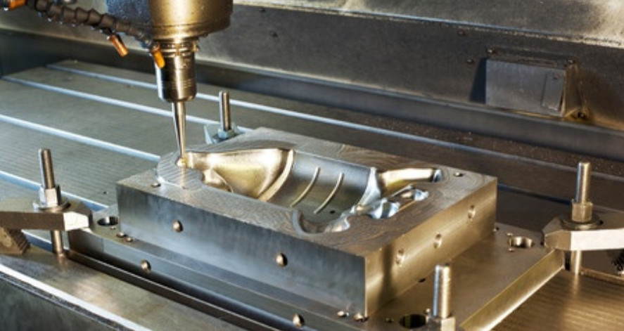
Tooling: molds and dies

Slide 42
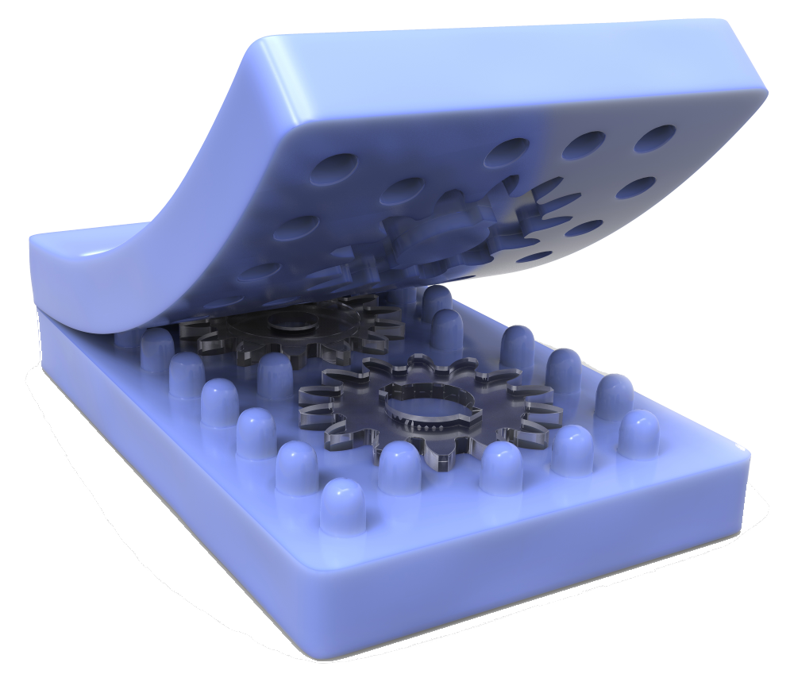
Soft Tooling

Slide 43
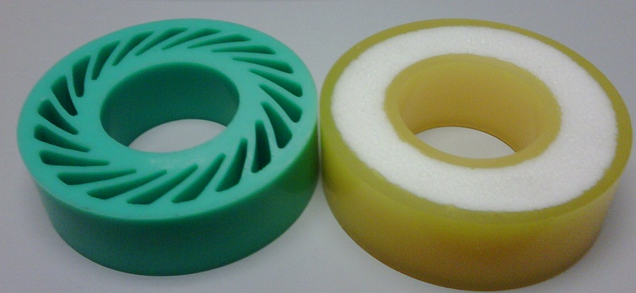
Elastomers

Slide 44
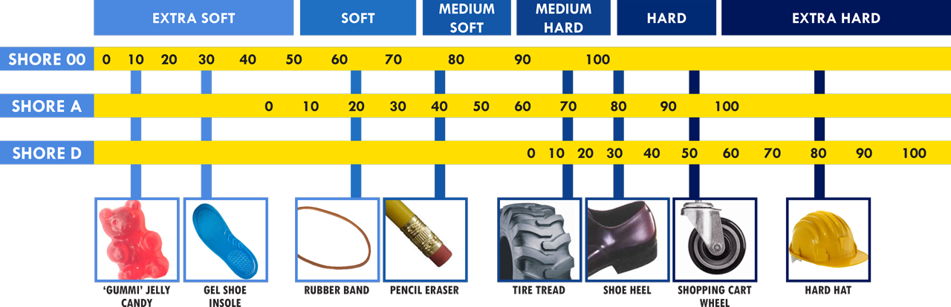
Shore Durometer

Slide 45
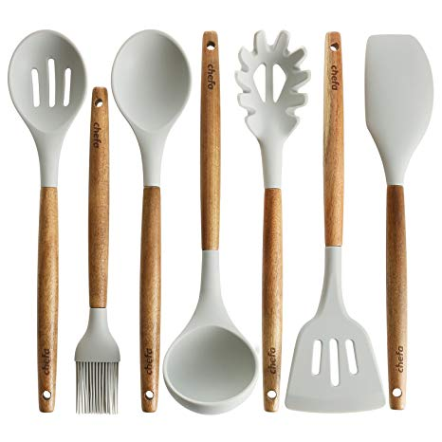
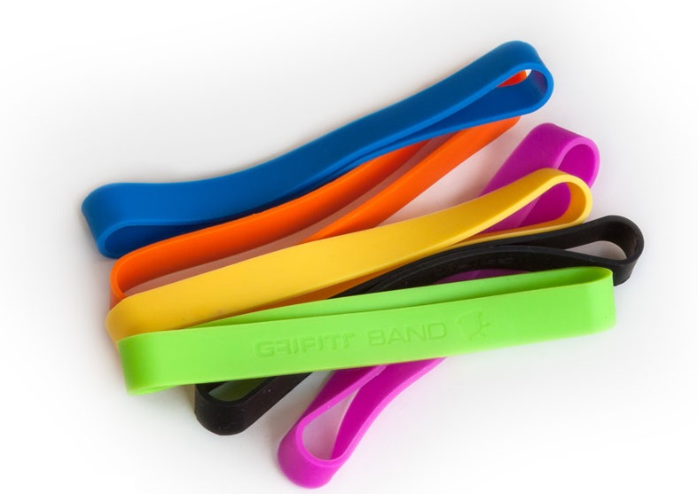
Silicone

Slide 46
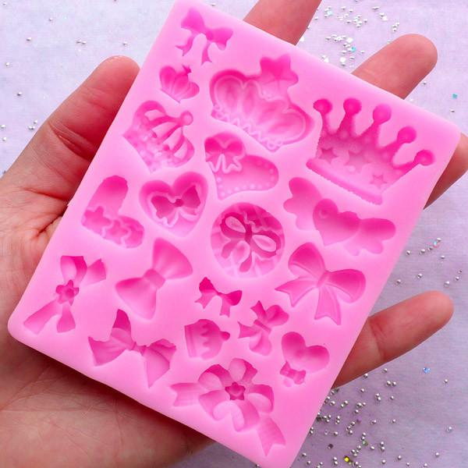
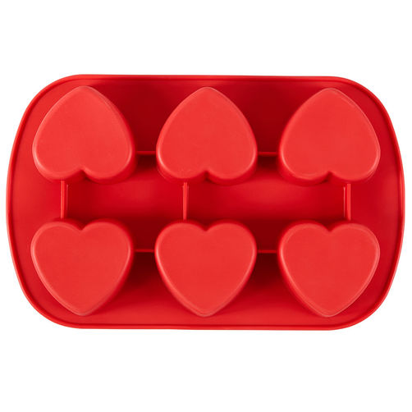
Silicone molds

Slide 47
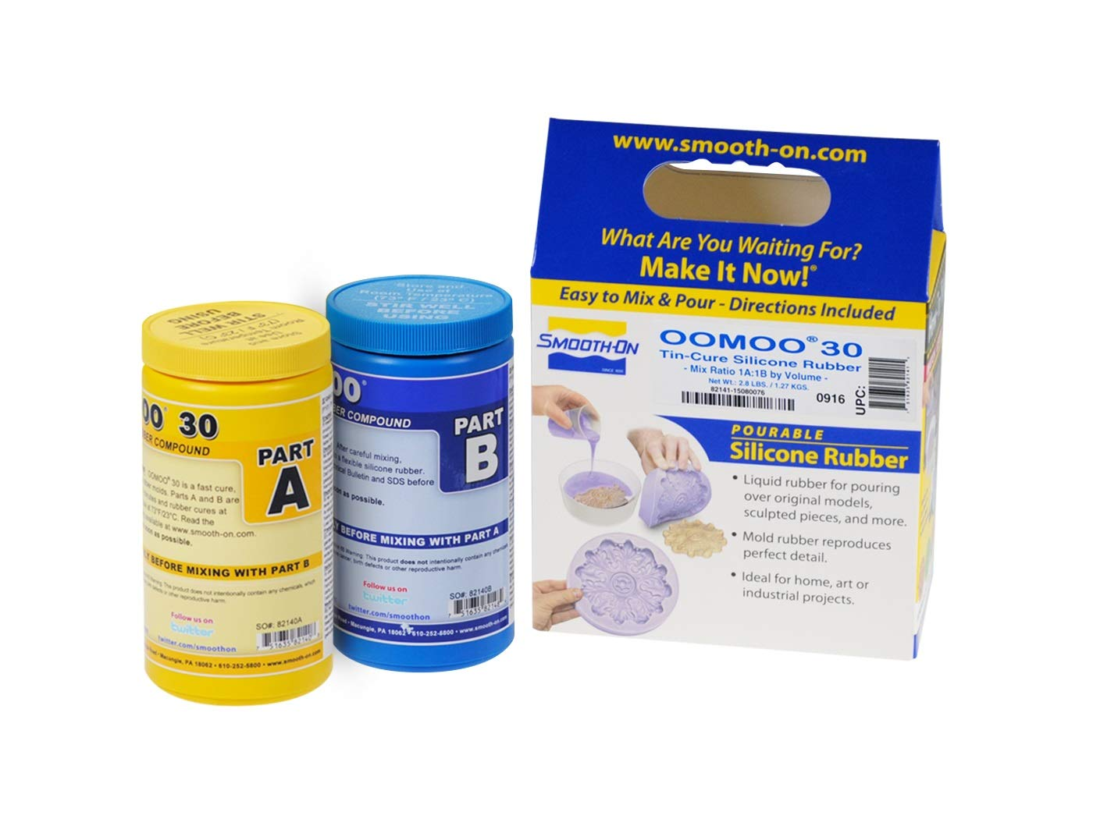
Oomoo
https://www.smooth-on.com/product-line/oomoo/

Slide 48
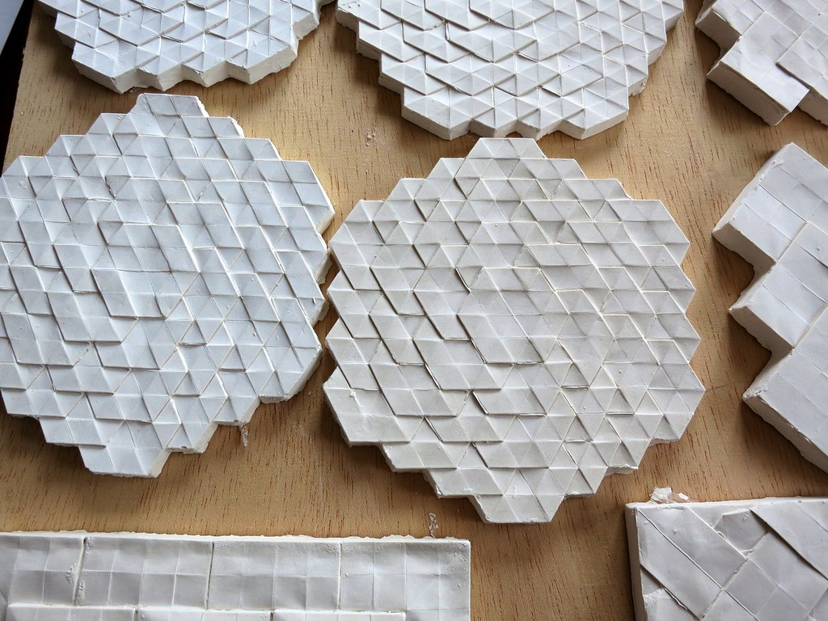
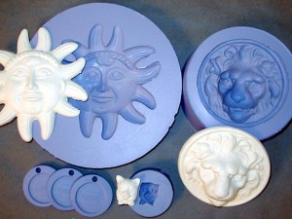
Plaster casting

Slide 49
How to make the molds?
3d printing
CNC milling

Slide 50
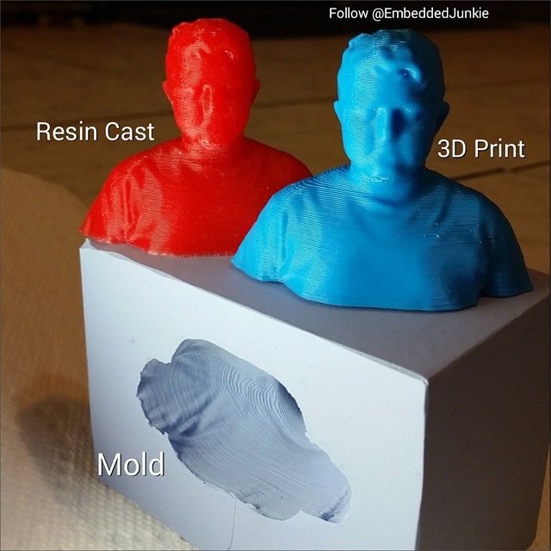
How to make the molds?

Slide 51


How to make the molds?

Slide 52

How to make the molds?

Slide 53

How to make the molds?

Slide 54

How to make the molds?
http://fab.cba.mit.edu/classes/863.12/people/hendranata.erioseto/week6_moulding+casting.html

